Slide 1

Software Workshop
EDAS Software Engineering 13:15 – 14:45

Slide 2

Meet the team
Our paths into engineering
Our experiences in BAE Systems

Slide 3


What is Software Engineering?
?

Slide 4
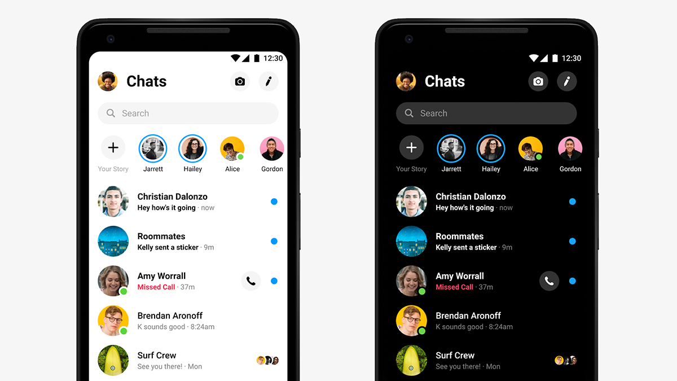




Problem Decomposition – Group Activity
Rock, Paper, Scissors
Messaging App
Fibonacci sequence

Slide 5

Practical Activity

Slide 6
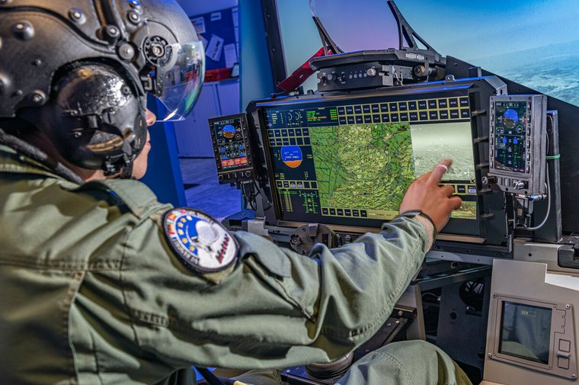
Scenario

Slide 7
Tasks
Design
Verification
User Interface
Code
Debugging
Testing
Front-end visual design
Use figma, draw.io, MS Paint etc
Produce a wireframe for the Radar Screen(s)
Consider input data, human-computer interaction, communicating your design ideas
Back-end code implementation
Use websites like programmiz to write code in browser
Mission: Find prime numbers to support cryptography
Find and fix the problems in the code below!
Create a system to test the code and report back on its performance
Consider normal test cases, abnormal cases, edge cases
Code @ github.com/30176298/jet-display
Any other ideas!

